Slide 1
Editor and Compiler

Slide 2
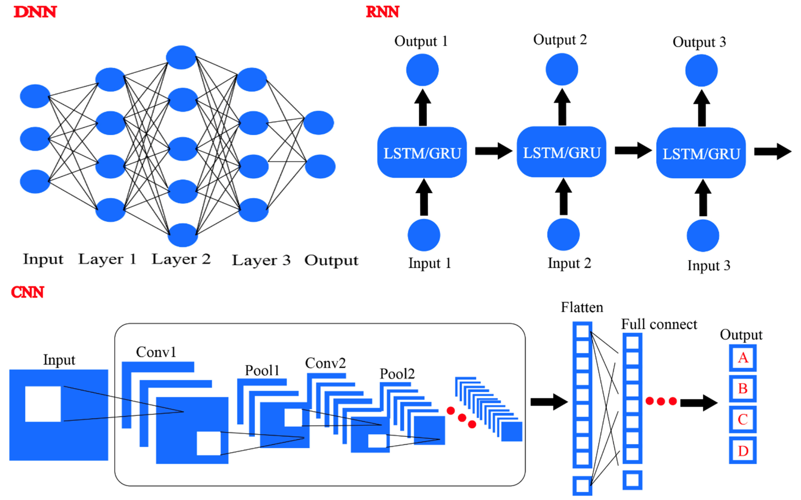
Outline

Slide 3
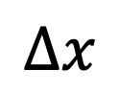

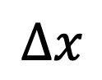
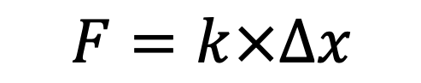

Finding Function
Independent Variable
Hooke's law
x
$$Δx$$
$$F$$
Feature
f
$$F=k×Δx$$
Dependent Variable
y
$$Δx$$
$$F$$
Label

Slide 4

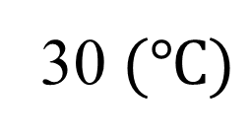
Function
Input
Output
f
20200804
30$(℃)$
f
“韓國瑜”
f
“她坐上了馬莎拉蒂
頭也不回的樣子”
“像極了愛情”
知名導演蘇文聖（蘇三毛）在網路上分享「教你如何寫詩」

Slide 5
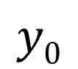
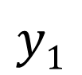
Fully Connected Neural Network
Layer 1
Layer 2
Layer 3
3 layers
Neuron
x₁
$$y0$$
x₂
$$y1$$
x₃
Input Layer
Hidden Layer
Output Layer

Slide 6
Hyperparameters
Layer 1
Layer L-1
Layer L
Size of Layers
Number of Layers

Slide 7
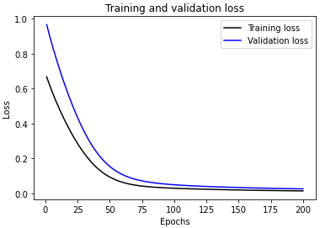
How to Build a Neural Network Model
Cross-Validation
Model
Initial
Dataset
Pre-processed
Dataset
Training
set
Neural Network
Hyperparameter optimization
80%
20%
Trained
Model
x₁ | x₂ | x₃ | y
0.1 | 0.11 | -0.11 | [1,0,0]
0.2 | 0.22 | -0.22 | [0,1,0]
0.3 | 0.33 | -0.33 | [0,0,1]
Test
set
Predicted
y values
Regression
Input
variables
Output
variables
Evaluate
Model
Performance
Mean Square Error
Classification
Accuracy

Slide 8
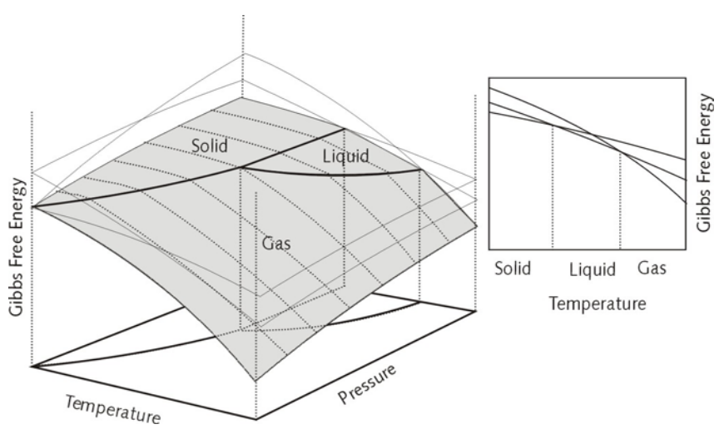
Input and Output
Feature |  | Label
x₁(P) | x₂(T) | y(phase)
1 | -273 | [1,0,0]
1 | 25 | [0,1,0]
1 | 1000 | [0,0,1]
. | . | .
1
0
0
1
-273
[1,0,0]
Pressure
[0,1,0]
0
1
0
1
25
Classification
[0,0,1]
Training
1
1000
0
0
1
Temperature
Feature |  |  | Label
x₁(P) | x₂(T) | x₃(phase) | y(Gibbs)
1 | -273 | [1,0,0] | 1.xxx
1 | 25 | [0,1,0] | 0
1 | 1000 | [0,0,1] | -2.xxx
. | . | . | .
1
-273
[1,0,0]
1.xxx
1
25
[0,1,0]
0
Regression
Training
1
1000
[0,0,1]
-2.xxx

Slide 9
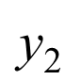
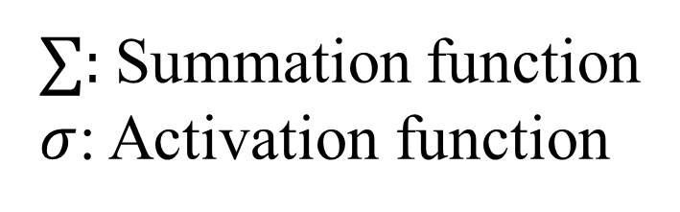

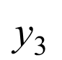

Neurons in Hidden and Output Layers
$$σ$$
$$∑$$
x₁
i₁
j₁
k₁
l₁
y₁
x₂
i₂
j₂
k₂
l₂
$$\text{y}\text{2}$$
x₃
i₃
j₃
k₃
l₃
$$\text{y}\text{3}$$
∑: Summation function
$σ$: Activation function
Input Layer
Hidden Layer
Output Layer

Slide 10

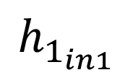

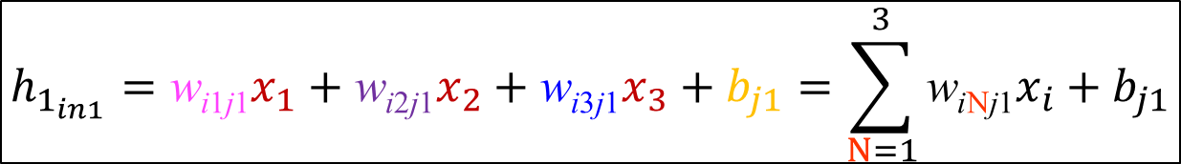

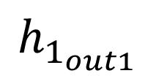


Summation Function in a Hidden Layer
Parameters: Weight (w) and Bias (b)
j₁ neuron
w_{i1j1}
Hidden 1 (h₁)
x₁
w_{i1j1}
x₁
i₁
j₁
$$y1$$
$$σ$$
w_{i2j1}
$$h_{1_{in1}}$$
$$h_{1_{out1}}$$
w_{i2j1}
$$∑$$
x₂
x₂
i₂
$$y2$$
w_{i3j1}
w_{i3j1}
x₃
i₃
x₃
$$y3$$
b_{j1}
b_{j1}
b_{j}
$${h_{1_{in1}}=\text{w}\text{i}\text{1}\text{j}\text{1}x}_{1}+\text{w}\text{i}\text{2}\text{j}\text{1}x_{2}+\text{w}\text{i}\text{3}\text{j}\text{1}x_{3}+b_{j1}=\sum_{N=1}^{3}{\text{w}\text{i}\text{N}\text{j}\text{1}x_{i}}+b_{j1}$$

Slide 11
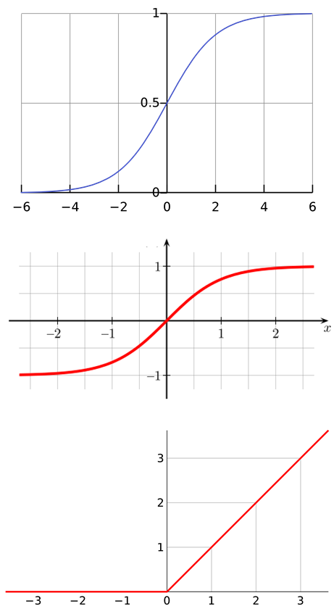
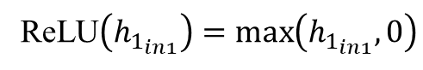
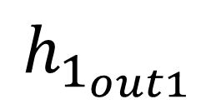
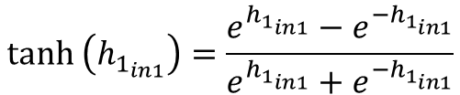

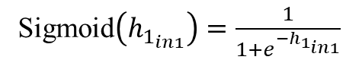
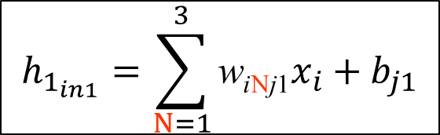

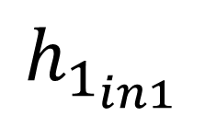
Activation Function in a Hidden Layer
Sigmoid
Sigmoid$\left(h_{1_{in1}}\right)=\frac{1}{1+e^{−h_{1_{in1}}}}$
w_{i1j1}
x₁
$$h_{1_{in1}}$$
$$σ$$
$$h_{1_{out1}}$$
w_{i2j1}
$$∑$$
x₂
tanh
$$tanh \left(h_{1_{in1}}\right){=\frac{e^{h_{1_{in1}}}−e^{−h_{1_{in1}}}}{e^{h_{1_{in1}}}+e^{−h_{1_{in1}}}}}$$
w_{i3j1}
x₃
b_{j1}
ReLU$\left(h_{1_{in1}}\right)=\max_{}\left(h_{1_{in1}},0\right)$
ReLU
$$h_{1_{in1}}=\sum_{N=1}^{3}{\text{w}\text{i}\text{N}\text{j}\text{1}x_{i}}+b_{j1}$$

Slide 12
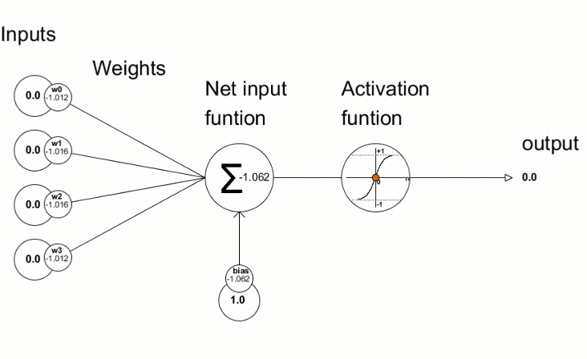
Activation Function

Slide 13
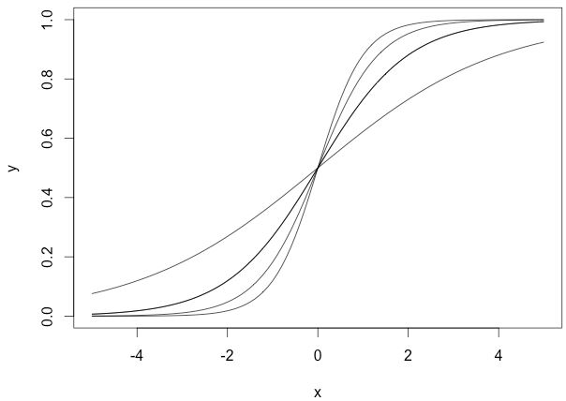
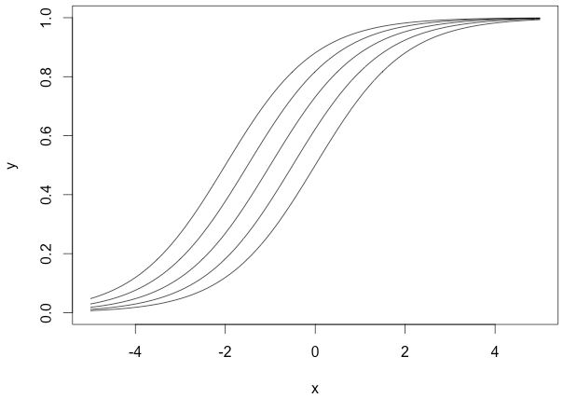
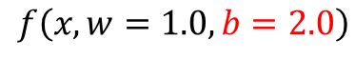
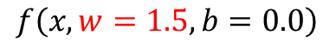
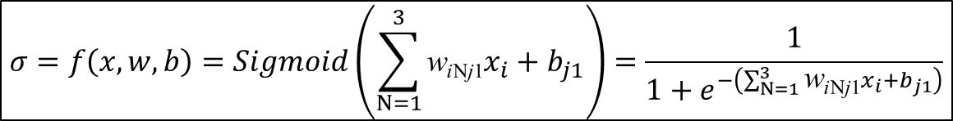
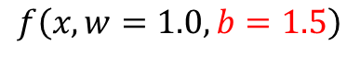
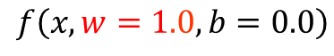
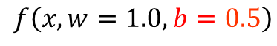
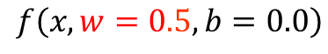
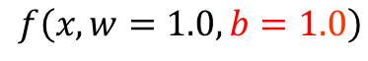
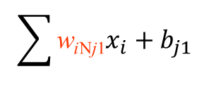
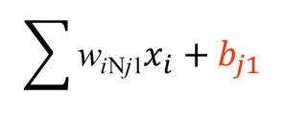

Bias
$$σ=f\left(x,w,b\right)=Sigmoid\left(\sum_{N=1}^{3}{\text{w}\text{i}\text{N}\text{j}\text{1}x_{i}}+b_{j1}\right)=\frac{1}{1+e^{−\left(\sum_{N=1}^{3}{\text{w}\text{i}\text{N}\text{j}\text{1}x_{i}}+b_{j1}\right)}}$$
𝜎
𝜎
$$f\left(x,w=0.5,b=0.0\right)$$
$$f\left(x,w=1.0,b=1.0\right)$$
$$f\left(x,w=1.0,b=0.0\right)$$
$$f\left(x,w=1.0,b=0.5\right)$$
$$f\left(x,w=1.5,b=0.0\right)$$
$$f\left(x,w=1.0,b=1.5\right)$$
$$f\left(x,w=2.0,b=0.0\right)$$
$$f\left(x,w=1.0,b=2.0\right)$$
$$\sum{\text{w}\text{i}\text{N}\text{j}\text{1}x_{i}}+b_{j1}$$
$$\sum{\text{w}\text{i}\text{N}\text{j}\text{1}x_{i}}+b_{j1}$$
Model will train over point passing through origin only
Model will become more flexible

Slide 14
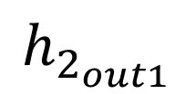
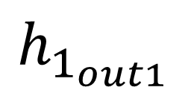
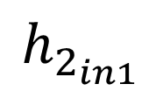
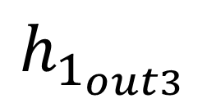
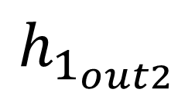
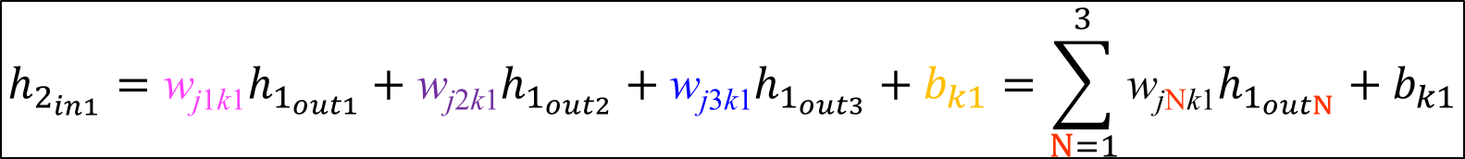
Summation Function in a Hidden Layer
Parameters: Weight (w) and Bias (b)
k₁ neuron
w_{j1k1}
Hidden 1 (h₁) 2 (h₂)
$$h_{1_{out1}}$$
w_{j1k1}
x₁
j₁
k₁
$$y1$$
$$σ$$
w_{j2k1}
$$h_{2_{in1}}$$
$$h_{2_{out1}}$$
w_{j2k1}
$$h_{1_{out2}}$$
$$∑$$
x₂
j₂
$$y2$$
w_{j3k1}
w_{j3k1}
x₃
$$h_{1_{out3}}$$
j₃
$$y3$$
b_{k1}
b_{k1}
b_{k}
$$h_{2_{in1}}=\text{w}\text{j}\text{1}\text{k}\text{1}h_{1_{out1}}+\text{w}\text{j}\text{2}\text{k}\text{1}h_{1_{out2}}+\text{w}\text{j}\text{3}\text{k}\text{1}h_{1_{out3}}+b_{k1}=\sum_{N=1}^{3}{\text{w}\text{j}\text{N}\text{k}\text{1}h_{1_{outN}}}+b_{k1}$$

Slide 15

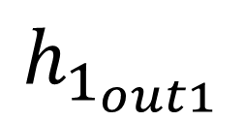
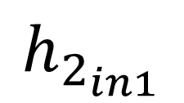
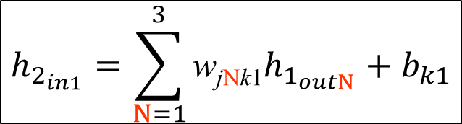
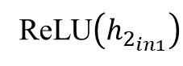
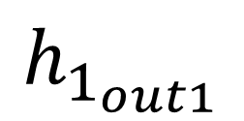
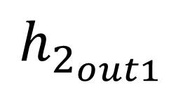




Activation Function in a Hidden Layer
Sigmoid
Sigmoid$\left(h_{2_{in1}}\right)$
w_{j1k1}
$$h_{1_{out1}}$$
$$h_{2_{in1}}$$
$$σ$$
$$h_{2_{out1}}$$
w_{j2k1}
$$∑$$
$$h_{1_{out1}}$$
tanh
$$tanh \left(h_{2_{in1}}\right){}$$
w_{j3k1}
$$h_{1_{out1}}$$
b_{k1}
ReLU$\left(h_{2_{in1}}\right)$
ReLU
$$h_{2_{in1}}=\sum_{N=1}^{3}{\text{w}\text{j}\text{N}\text{k}\text{1}h_{1_{outN}}}+b_{k1}$$

Slide 16









Summation Function in a Output Layer
Parameters: Weight (w) and Bias (b)
l₁ neuron
w_{k1l1}
Output (o)
$$h_{2_{out1}}$$
w_{k1l1}
x₁
k₁
l₁
$$oout1$$
$$σ$$
w_{k2l1}
$$o_{in1}$$
$$o_{out1}$$
w_{k2l1}
$$h_{2_{out2}}$$
$$∑$$
x₂
k₂
$$o2$$
w_{k3l1}
w_{k3l1}
x₃
$$h_{2_{out3}}$$
k₃
$$o3$$
b_{l1}
b_{l1}
b_{l}
$$o_{in1}=\text{w}\text{k}\text{1}\text{l}\text{1}h_{2_{out1}}+\text{w}\text{k}\text{2}\text{l}\text{1}h_{2_{out2}}+\text{w}\text{k}\text{3}\text{l}\text{1}h_{2_{out3}}+b_{l1}=\sum_{N=1}^{3}{\text{w}\text{j}\text{N}\text{k}\text{1}h_{2_{outN}}}+b_{l1}$$

Slide 17













Choosing Activation Function
Input
$$h_{1}$$
$$h_{2}$$
Output
$$σ$$
$$∑$$
i₁
j₁
k₁
o_{in1}
$$\text{o}\text{out}\text{1}$$
$$σ$$
Classification
or
Regression?
$$∑$$
i₂
$$\text{j}\text{2}$$
k₂
o_{in2}
$$\text{o}\text{out}\text{2}$$
$$σ$$
i₃
$$\text{j}\text{3}$$
k₃
$$∑$$
o_{in3}
$$\text{o}\text{out}\text{3}$$
Activation function:
ReLU
Activation function:
???

Slide 18








Regression
Lv
Loss=???
𝜎 = Linear function
Turret damage
$$\text{o}\text{out}\text{1}$$
$$\text{o}\text{out}\text{1}=\text{o}\text{in}\text{1}$$
o_{in1}=$\sum{\text{w}\text{j}\text{N}\text{k}\text{1}h_{2_{outN}}}+b_{l1}$

Slide 19












Regression
Input
$$h_{1}$$
$$h_{2}$$
Output
Label
$$σ$$
$$∑$$
Interfacial
Tension
y₁
$$\text{T}\text{emperature}$$
i₁
j₁
k₁
o_{in1}
$$\text{o}\text{out}\text{1}$$
(Prediction)
(Experiment)
$$\text{Pressure}$$
i₂
$$\text{D}\text{ensity}$$
$$\text{difference}$$
i₂
$$\text{j}\text{3}$$
k₃
[$\text{o}\text{in}\text{1}$] = [34.59]
$$\text{o}\text{out}\text{1}=\text{o}\text{in}\text{1}$$
[$\text{o}\text{out}\text{1}$] = [34.59]

Slide 20







Classification
Binary Classification Problem
- Only one right answer
Categories = 2 | Binary Classification
Positive [1] Negative [0]
Multi-Label Classification Problem
-More than one right answer
-Non-exclusive outputs
Multi-Class Classification Problem
-Only one right answer
-Mutually exclusive outputs
[0]
[1]
Categories = 6 | Multilabel Classification | Multiclass Classification (Single Label)
Assassin [1 0 0 0 0 0] Tank [0 1 0 0 0 0] Mage [0 0 1 0 0 0] Support [0 0 0 1 0 0] Fighter [0 0 0 0 1 0] Marksman [0 0 0 0 0 1]
[0 1 1 0 0 0]
[0 0 0 1 0 1]
[1 0 0 0 1 0]
[1 0 0 0 0 0]
[0 0 1 0 0 0]
[0 0 0 0 0 1]

Slide 21













Binary Classification
Health points lost?
Yes
or
Sigmoid
No
$$\text{o}\text{out}\text{1}$$
$\text{o}\text{in}\text{1}\text{>0 =>}$more than 50% probability that Health points will lost
$\text{o}\text{in}\text{1}\text{<}\text{0 =>}$less than 50% probability that Health points will not lost
$\text{o}\text{in}\text{1}\text{>0 =>}$exactly 50% probability that Health points will lost
$$\text{o}\text{in}\text{1}$$

Slide 22










Binary Classification Problem
Input
$$h_{1}$$
$$h_{2}$$
Output
$$σ$$
Input
Label
$$∑$$
positive 1
negative 0
i₁
j₁
k₁
o_{in1}
$$\text{o}\text{out}\text{1}$$
[y₁]=[1]
COVID-19
$$\text{o}\text{out}\text{1}$$
i_{m}
$$\text{j}\text{m}$$
k_{m}
[$\text{o}\text{in}\text{1}$] = [2.4]
$$Sigmoid\left(o_{in1}\right)=\frac{1}{1+e^{−o_{in1}}}$$
Activation function (Sigmoid)
One neuron in a output layer
Only one right answer (One neuron)
[$\text{o}\text{out}\text{1}$] = [0.92]
The probability that the input image belongs to COVID-19 is exactly 92%

Slide 23
Binary Classification
Health points lost?
Yes
or
No
Softmax

Slide 24







Binary Classification Problem
Input
$$h_{1}$$
$$h_{2}$$
Output
$$σ$$
Input
Label
$$∑$$
positive 1
negative 0
i₁
j₁
k₁
o_{in1}
$$\text{o}\text{out}\text{1}$$
$$σ$$
$$∑$$
[y₁,y₂]=[1,0]
o_{in2}
$$\text{o}\text{out}\text{2}$$
COVID-19
$$\text{o}\text{out}\text{1}\text{ 2}$$
i_{m}
$$\text{j}\text{m}$$
k_{m}
[$\text{o}\text{in}\text{1}\text{,} \text{o}\text{in}\text{2}$] = [2.4,-0.5]
$$Softmax\left(o_{inx}\right)=\frac{e^{o_{inx}^{}}}{e^{o_{in1}^{}}+e^{o_{in2}^{}}}$$
Activation function (Softmax)
Two neurons in a output layer
Only one right answer
[$\text{o}\text{out}\text{1}\text{,} \text{o}\text{out}\text{1}$] = [0.95,0.05]
The probability that the input image belongs to COVID-19 is exactly 95%

Slide 25


Multilabel Classification Problem
Assassin (0.66)
Tank (0.11)
Mage (0.13)
Support (0.35)
Fighter (0.21)
Marksman (0.79)
Sigmoid

Slide 26


















Multilabel Classification Problem
Input
$$h_{1}$$
$$h_{2}$$
Output
Input
Label
$$σ$$
$$∑$$
o_{in1}
i₁
j₁
k₁
$$\text{o}\text{out}\text{1}$$
pneumonia
cardiomegaly
nodule
abscess
0
1
0
1
$$σ$$
$$∑$$
o_{in2}
$$\text{o}\text{out}\text{2}$$
$$σ$$
$$∑$$
o_{in3}
[y₁,y₂, y₃,y₄]=[0 1 0 1]
$$\text{o}\text{out}3$$
$$σ$$
$$\text{o}\text{out}\text{1}\text{ 2 3 4 }$$
$$∑$$
i_{m}
$$\text{j}\text{m}$$
k_{m}
o_{in4}
$$\text{o}\text{out}4$$
[o_{in1,} o_{in2,} o_{in3,} o_{in4}] = [-0.5, 1.2, -0.1, 2.4]
Activation function (Sigmoid)
More than one right answer
Non-exclusive outputs
$$Sigmoid\left(y_{inx}\right)=\frac{e^{o_{inx}}}{1+e^{o_{inx}}}$$
[o$\text{out}$_{1,} o$\text{out}$_{2,} o$\text{out}$_{3,} o$\text{out}$₄] = [0.37, 0.77, 0.48, 0.91]

Slide 27


Multi-Class Classification Problem
Assassin (0.96)
Tank (0.01)
Mage (0.005)
Support (0.005)
Fighter (0.01)
Marksman (0.01)
Softmax

Slide 28




Multi-Class Classification Problem
Input
$$h_{1}$$
$$h_{2}$$
Output
Input
Label
$$σ$$
$$∑$$
o_{in1}
i₁
j₁
k₁
$$\text{o}\text{out}\text{1}$$
$$σ$$
$$∑$$
[y₁, y₂, y₃, y₄]
o_{in2}
$$\text{o}\text{out}\text{2}$$
$$σ$$
[y₁,y₂, y₃,y₄]=[0 0 1 0]
$$∑$$
o_{in3}
$$\text{o}\text{out}\text{1}\text{ 2 3 4 }$$
$$\text{o}\text{out}3$$
$$σ$$
[o_{in1,} o_{in2,} o_{in3,} o_{in4}] = [-0.5, 1.2, 2.4, -0.1]
$$∑$$
i_{m}
$$\text{j}\text{m}$$
k_{m}
o_{in4}
$$\text{o}\text{out}4$$
$$Softmax\left(o_{inx}\right)=\frac{e^{o_{inx}^{}}}{e^{o_{in1}^{}}+e^{o_{in2}^{}}+e^{o_{in3}^{}}+e^{o_{in4}^{}}}$$
Multi-Class Classification Problem
Only one right answer
Mutually exclusive outputs
[o$\text{out}$_{1,} o$\text{out}$_{2,} o$\text{out}$_{3,} o$\text{out}$₄] = [0.04, 0.21, 0.70, 0.05]
Sum=1

Slide 29

Superposition Property
Input Layer
Output Layer
$$f=σ\left(\sum{W_{…}σ\left(\sum{W_{…}σ\left(\sum{W_{…}Input}+b_{…}\right)}+b_{…}\right)}+b_{…}\right)$$
Hidden Layer

